Slide 1
SSENSE.com Recommendation Engine
an end-to-end data science project
by Tri Nguyen
github.com/nqtri/SSENSE-Product-Recommendation-System

Slide 2
Agenda
Introduction
Data Collection & Exploratory Data Analysis
Feature Engineering
Recommendation Engine
Web App Deployment & Demo
Business Impact Evaluations
Limitations & Next Steps

Slide 3
INTRODUCTION

Slide 4
What & Why?
SSENSE.com
Favorite Canadian online retailer
There was no recommendation engine on the site
Difficulty to find replacement product of a chosen one is sold out
Natural Language Processing (NLP)
Term Frequency – Inverse Document Frequency (TF-IDF) concept
Topic Modeling Techniques
Full Data Science Development Pipeline
Real life data
A model should not simply stay in Jupyter Notebook

Slide 5
Use Cases
A wish-listed product is sold out
Problem
Users redirected to homepage when the sold-out product was clicked on
Solution
An engine that can redirect to page compiled of similar products
Products from other overseas retailers (Farfetch, Mr. Porter, etc.)
Problem
Not based in Canada, buyers are subject to heavy tax and duties
Solution
An engine that can take an offsite product’s descriptions and recommend similar products available on SSENSE.com

Slide 6
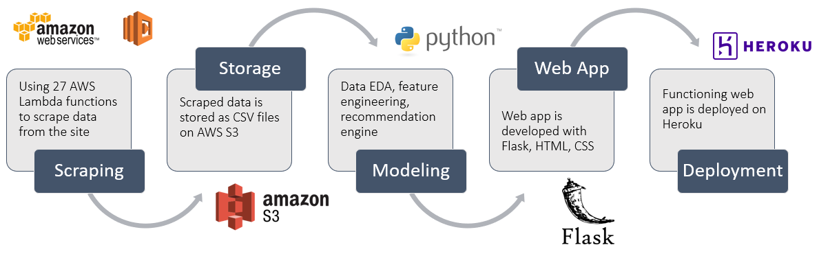
Development Process

Slide 7
DATA COLLECTION & EDA

Slide 8
Data Collection
The process has 2 stages
Getting product URLs
Looping through HTML script of each product category page to extract the JSON objects containing the URLs
Split into 4 categories (tops, bottoms, footwear, accessories) with 4 separate AWS Lambda functions
Getting product details (brands, names, description, prices, sizes, etc.)
Accessing each product URLs to obtain products’ detail from their JSON objects
Due to max runtime limit of 15 mins, 23 AWS Lambda functions were used, each handled approx. 1,500 products
Extracted information is processed, combined, and stored on AWS S3

Slide 9
Exploratory Data Analysis
88
Categories
28,992
Products
432
Brands
19+
Countries of Origin

Slide 10
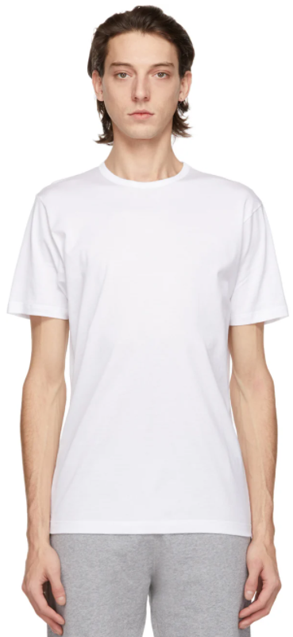
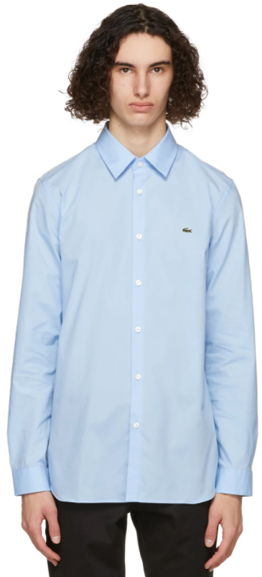
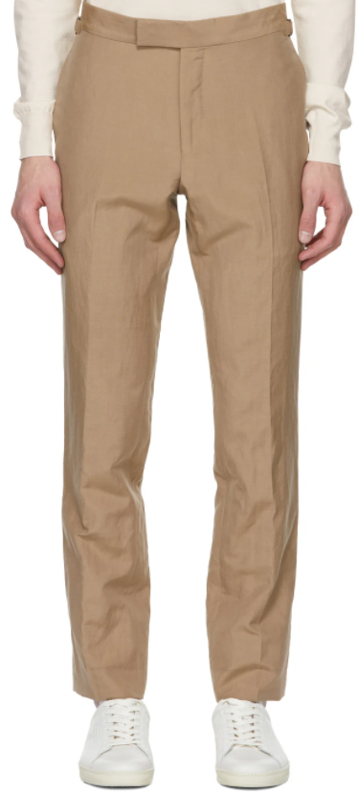
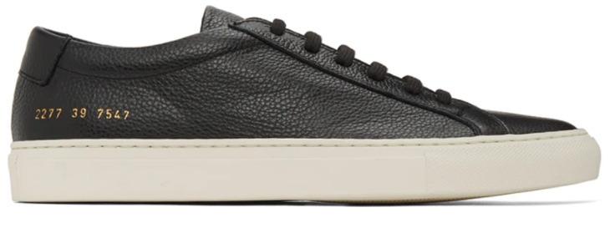
Top Product Categories
Low Top Sneakers
Shirts
Trousers
T-shirt

Slide 11




Most Popular Brands

Slide 12
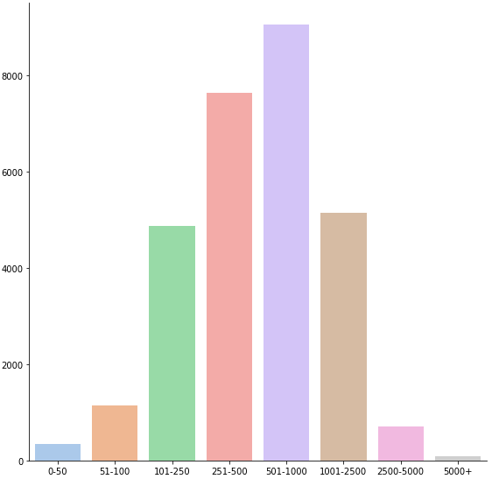
Prices
Price Range Histogram
# of Items
Price Range

Slide 13
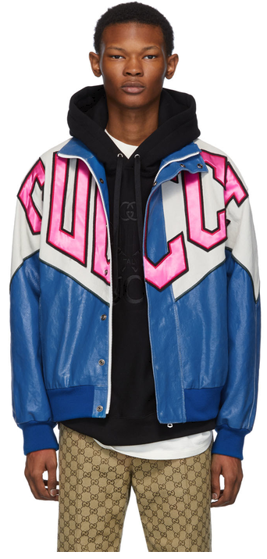
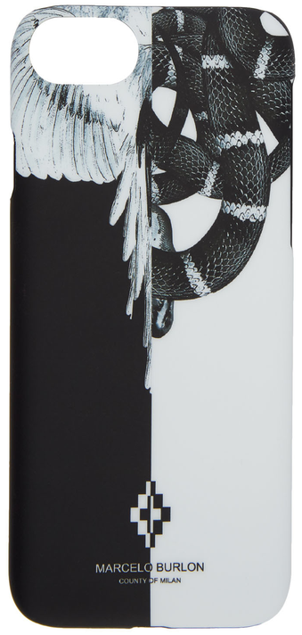
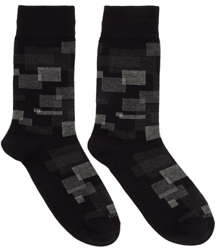
Max Price
$9,450
Min Price
$9
Most Discount
70%
Gucci Blue Banana Bomber Jacket
Hugo Boss Black RS Square Socks
Marcelo Burlon iPhone 8 Case

Slide 14
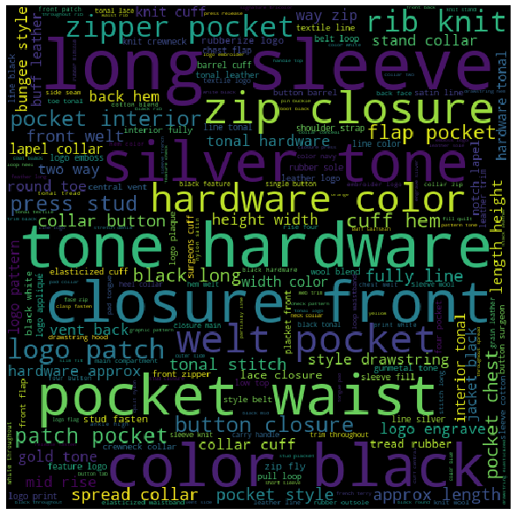
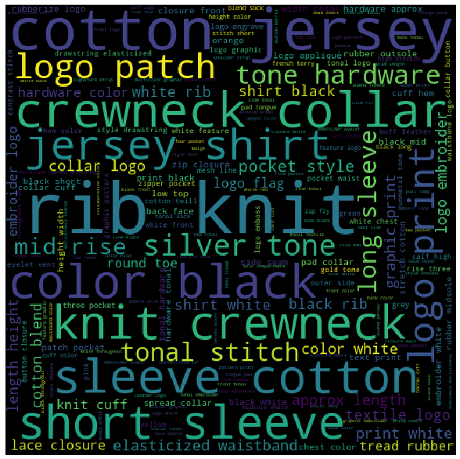
Top 5,000 by Sale Price
Bottom 5,000 by Sale Price

Slide 15
Feature Engineering

Slide 16
Easy Features
Features like ‘categories’, ‘brands’, ‘origins’, and ‘sizes’ are already well classified
Some brands such as collaborations require more attention
Words describing colors (i.e. red, yellow, offwhite)
Words describing materials (i.e. cotton, wool, leather)
Encoded with Multi-Label Binarizer

Slide 17
Easy Features - Multi-Label Binarizer
Item | Sub-category
a | Heavy coat
b | Rain coat
c | Jacket
Item | ‘heavy’ | ‘rain’ | ‘coat’ | ‘jacket’
a | 1 | 0 | 1 | 0
b | 0 | 1 | 1 | 0
c | 0 | 0 | 0 | 1
MultiLabelBinarizer()

Slide 18
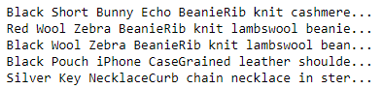
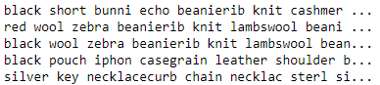
‘name’ and ‘description’ features
Pure text, requires more complicated processing
Combined and preprocessed with techniques like lemmatization and stemming
*Lemmatization & stemming: grouping together inflected form of a word (i.e. adjustable -> adjust, better -> good)

Slide 19
Topic Modelling (50 Topics Limit)
Non-Negative Matrix Factorization (Linear-algebra model)
Preprocessed text vectorized by Term Frequency–Inverse Document Frequency (TF-IDF)
Latent Dirichlet Allocation (Probabilistic model)
Preprocessed text vectorized by Term Frequency (TF) technique
TF: (# of times word t appears in an item’s description) / (Total # of words in an item’s description)
IDF: log(Total # of items / # of items with word t in it)

Slide 20
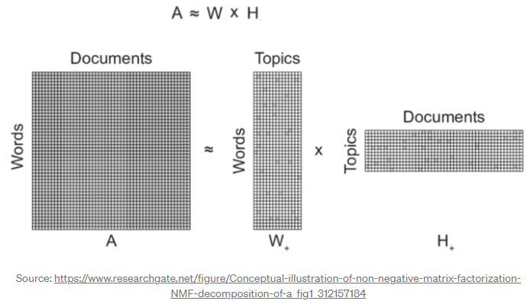
Non-Negative Matrix Factorization (NMF)
Used to identify latent structure in feature data represented as a non-negative matrix

Slide 21
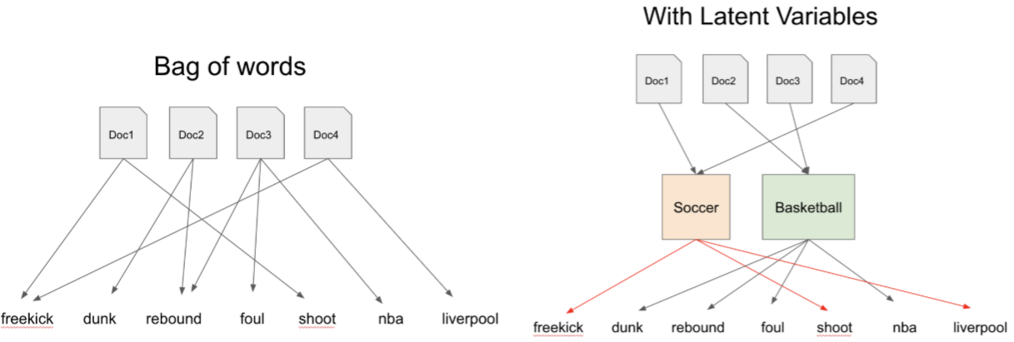
Latent Dirichlet Allocation (LDA)
An item is a probability distribution of clothing topics P(topic | item), and every topic is a probability distribution of words in product names and descriptions P(word | topic)
Source: towardsdatascience.com/dimensionality-reduction-with-latent-dirichlet-allocation-8d73c586738c

Slide 22
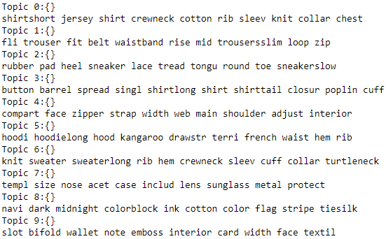
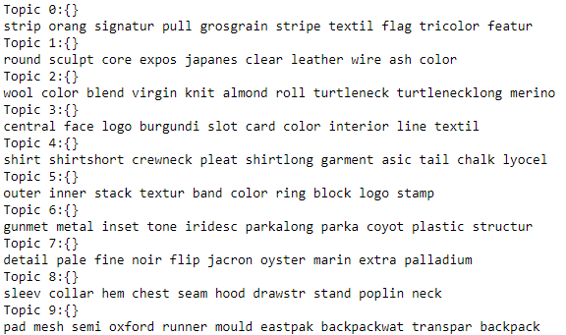
Non-Negative Matrix Factorization
Latent Dirichlet Allocation

Slide 23
Topics Generation Demo
''' burgundy wool crew neck panelled jumper from E. Tautz featuring a ribbed crew neck, long sleeves, elasticated cuffs, a panelled colour block design and a relaxed fit. '''
Sample Text 1
Non-Negative Matrix Factorization
Latent Dirichlet Allocation
['neck’, 'mock’, 'cardigan’, 'cardiganlong’, 'tank’, 'knit’, 'collar’, 'funnel’, 'rib’, 'topsleeveless']
['logo’, 'collar’, 'heel’, 'toe’, 'color’, 'cotton’, 'knit’, 'jersey’, 'sole’, 'rib']

Slide 24
Topics Generation Demo
''' Rectangular metal-frame sunglasses in gold-tone. Transparent rubber nose pads. Green ZEISS© lenses with 100% UVA/UVB protection. Logo etched at temples. Tortoiseshell acetate temple tips in tones of brown. Size: 143.20 140. Supplier color: Gold/Green '''
Sample Text 2
Non-Negative Matrix Factorization
Latent Dirichlet Allocation
['templ’, 'size’, 'nose’, 'acet’, 'case’, 'includ’, 'lens’, 'sunglass’, 'metal’, 'protect']
['slip’, 'includ’, 'logo’, 'templ’, 'size’, 'pad’, 'case’, 'color’, 'nose’, 'acet']

Slide 25
Recommendation Engine

Slide 26
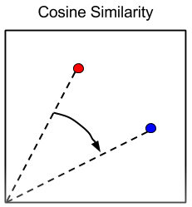
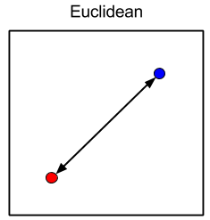
Similarity Metrics
Content-based recommendation engine
2 metrics are employed
Cosine Similarity
Calculate the cosine of the angle between two product vectors
Euclidean Distance
Calculate distance between two points on the feature plane

Slide 27
Similarity Matrix & Ranking
Item | Paul Smith Gray T-shirt | Fred Perry Gray Polo | Lacoste Pique Polo | Levi’s Denim Jacket
Paul Smith Gray Polo | 0 | 0.2 | 0.4 | 0.9
Fred Perry Gray Polo | 0.2 | 0 | 0.3 | 1
Lacoste Pique Polo | 0.4 | 0.3 | 0 | 0.8
Levi’s Denim Jacket | 0.9 | 1 | 0.8 | 0
Paul Smith Gray T-shirt
Rank | Similar Item
1 | Fred Perry Gray Polo
2 | Lacoste Pique Polo
3 | Levi’s Denim Jacket

Slide 28
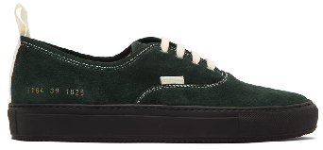
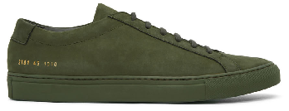
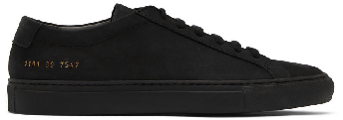
Scenario 1: Existing SSENSE Product
INPUT
Brand: Common Projects
Name: SSENSE Exclusive Green Suede Achilles Sneakers
Description: Lop-top suede sneakers in green. Round toe. Tonal lace-up closure. Padded tongue and collar. Signature series number stamped in gold-tone at sides. Tonal treaded rubber sole.
Color: Olive
Origin: Italy
Composition: Upper: leather. Sole: rubber
Full Price: 592
Sale Price: 345
Remaining Sizes: 39,40, 41, 42, 43, 44, 46, 47
OUTPUT 1
Brand: Common Projects
Name: SSENSE Exclusive Black Suede Achilles Sneakers
Description: Low-top suede sneakers in black. Round toe. Tonal lace-up closure. Padded tongue. Signature series number stamp in gold-tone at outer side. Tonal treaded rubber sole.
Color: Black
Origin: Italy
Composition: Upper: leather. Sole: rubber
Full Price: 592
Sale Price: 418
Remaining Sizes: 39,40, 41, 42, 43, 44, 45, 46, 47
OUTPUT 2
Brand: Common Projects
Name: Green Four Hole Low Sneakers
Description: Low-top suede sneakers in green. Round toe. Lace-up closure in white. Pull-loop in white at heel collar and vamp. Series number stamp in gold-tone at outer side. Leather lining in off-white. Treaded rubber sole in black. Tonal hardware.
Color: Green
Origin: Italy
Composition: Upper: leather. Sole: rubber
Full Price: 600
Sale Price: 288
Remaining Sizes: 39,40, 41, 42, 43, 44, 45, 46

Slide 29
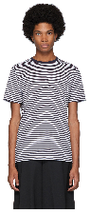
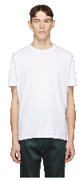
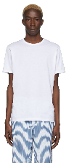
Scenario 1: Existing SSENSE Product
INPUT
Brand: Sunspel
Name: White & Navy English Stripe T-Shirt
Description: Short sleeve cotton jersey t-shirt striped in white and navy. Rib knit crewneck collar in navy.
Color: White /Navy
Origin: United Kingdom
Composition: 100% cotton
Full Price: 135
Sale Price: 69
Remaining Sizes: XS, S, XL, XXL
OUTPUT 1
Brand: Sunspel
Name: White Classic T-Shirt
Description: Short sleeve cotton jersey t-shirt in white. Rib knit crewneck collar. Tonal stitching.
Color: White
Origin: United Kingdom
Composition: 100% cotton
Full Price: 115
Sale Price: 61
Remaining Sizes: S, XXL
OUTPUT 2
Brand: Sunspel
Name: White Cotton Classic T-Shirt
Description: Short sleeve cotton jersey t-shirt in white. Crewneck collar.
Color: White
Origin: United Kingdom
Composition: 100% cotton
Full Price: 100
Sale Price: 100
Remaining Sizes: XS, S, M, L, XL

Slide 30

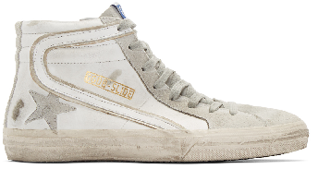
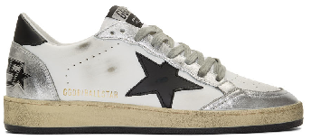
Scenario 2: Product from Other Sites
OUTPUT 1
Brand: Golden Goose
Name: White Slide Sneakers
Description: High-top panelled buffed leather and suede sneakers in white and grey. Smudging and distressing throughout. Lace-up closure in grey. Logo flag at tongue. Gold-tone logo stamp, stripe appliqué, and signature star appliqué at outer side. Zip closure at inner.
Color: White leather
Origin: Italy
Composition: Upper: leather. Sole: rubber
Full Price: 720
Sale Price: 547
Remaining Sizes: 42
OUTPUT 2
Brand: Golden Goose
Name: White & Silver Ball Star Sneakers
Description: Handcrafted low-top buffed leather sneakers in white and metallic silver-tone. Distressing, smudging, and perforated detailing throughout. Round toe. Lace-up closure in grey. Textile logo appliqué at white padded ripstop tongue. Padded collar. Signature star appliqué in black at outer side. Heel tab in black. Logo graphic embossed in black at heel counter. Rubber midsole in off-white. Treaded rubber outsole in black.
Color: White/Silver/Black
Origin: Italy
Composition: Upper: leather. Sole: rubber.
Full Price: 640
Sale Price: 403
Remaining Sizes: 41, 42, 44, 47
TEXT INPUT
Category: Sneakers
Brand: Golden Goose
Name: Starter low-top sneakers
Description: Trying to set a new personal record in competitive athleisure? Crafted from calf leather, these white Starter low-top sneakers from Golden Goose will get you a spot at the podium in no time. Ready? Set. Go! Featuring a round top, a lace-up front fastening, a contrasting heel counter, a brand embossed tongue, a pull tab at the rear, eyelets and a signature star patch detail to the side.
Color: white, silver
Origin: Italy
Composition: Outer: Calf Leather 100% Lining: Cotton 100%, Leather 100% Sole: Rubber 100%
Full Price: 770
Sale Price: 616
Remaining Sizes: 41, 42

Slide 31
Web Application ssense-recoengine.herokuapp.com

Slide 32
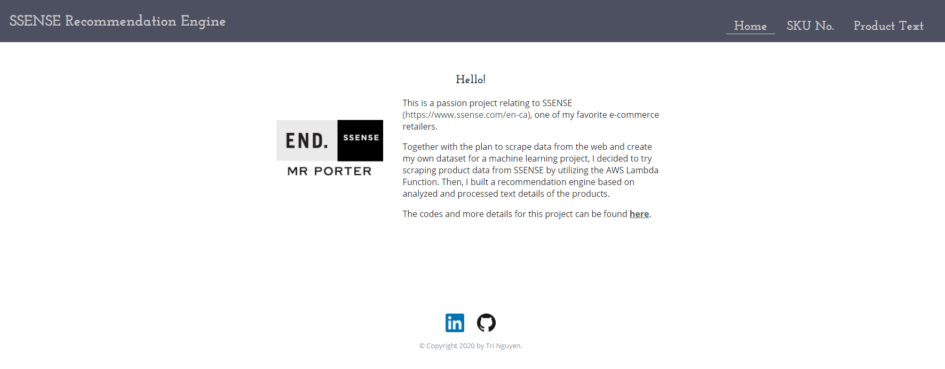
Homepage

Slide 33
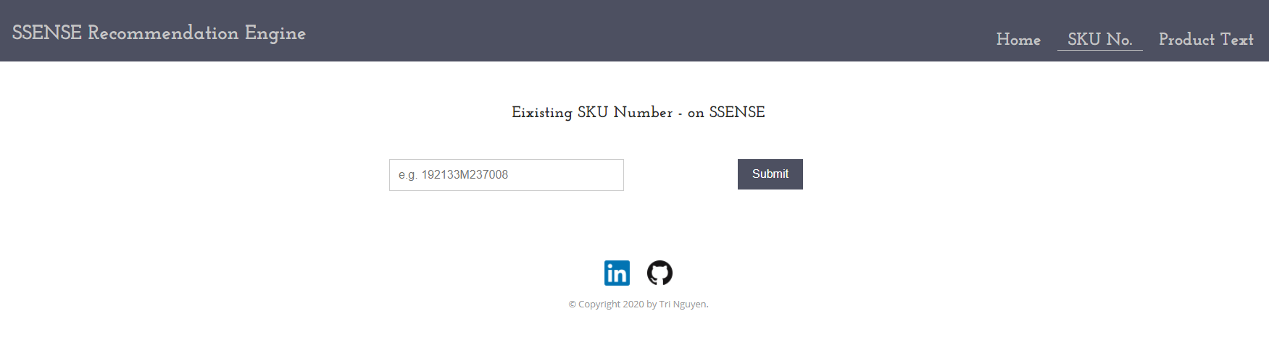
Existing Product Tab

Slide 34
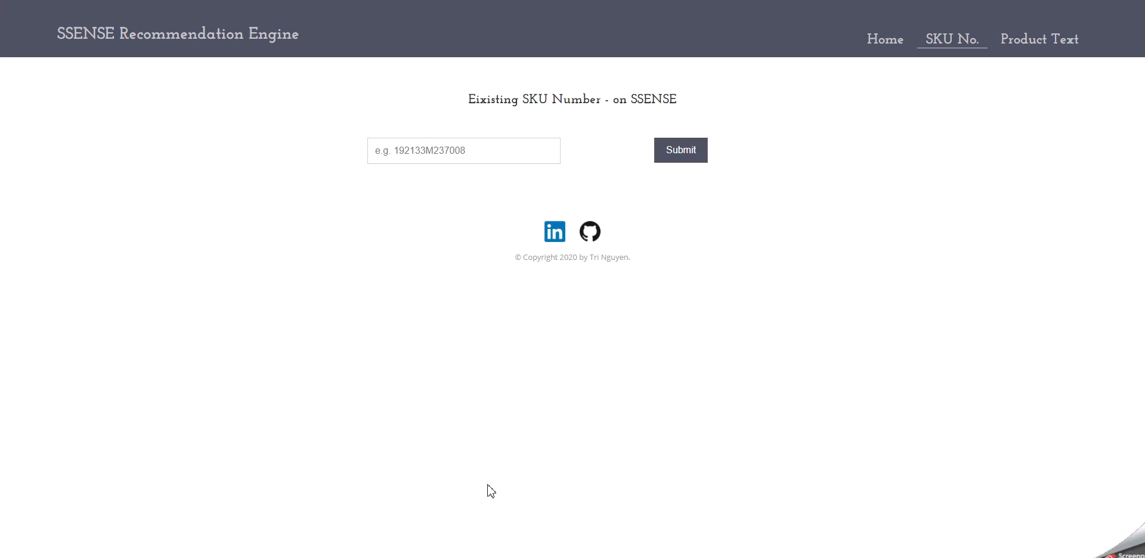

Slide 35
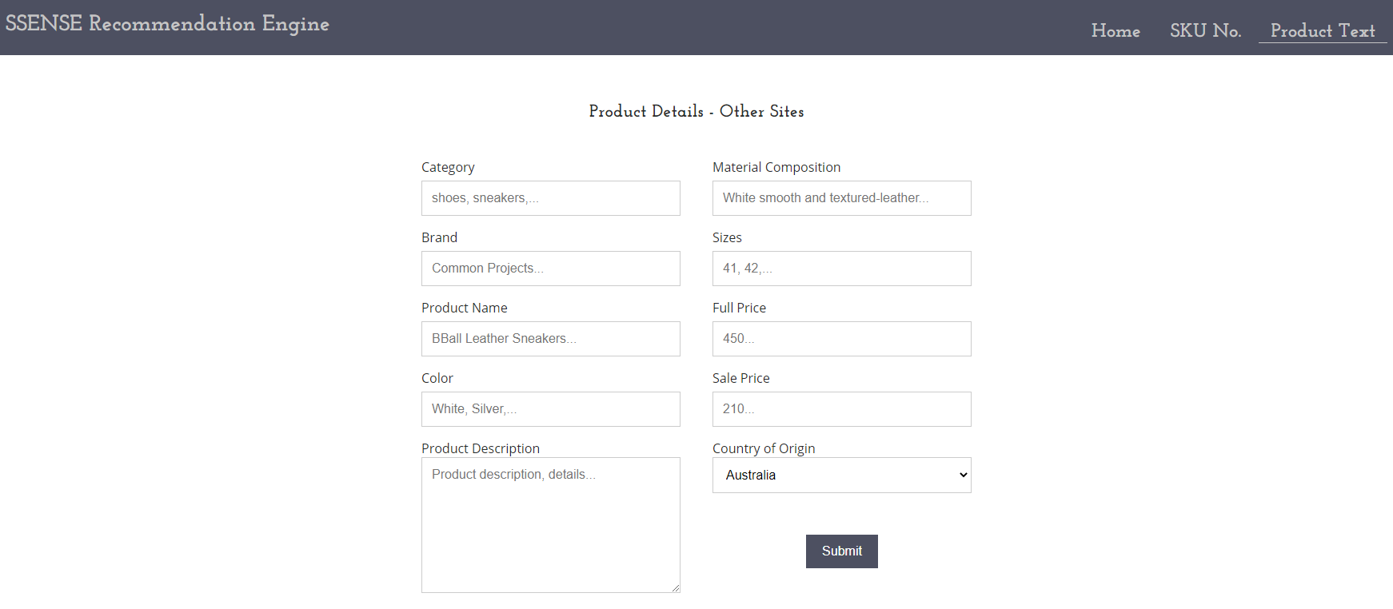
External Product Tab

Slide 36
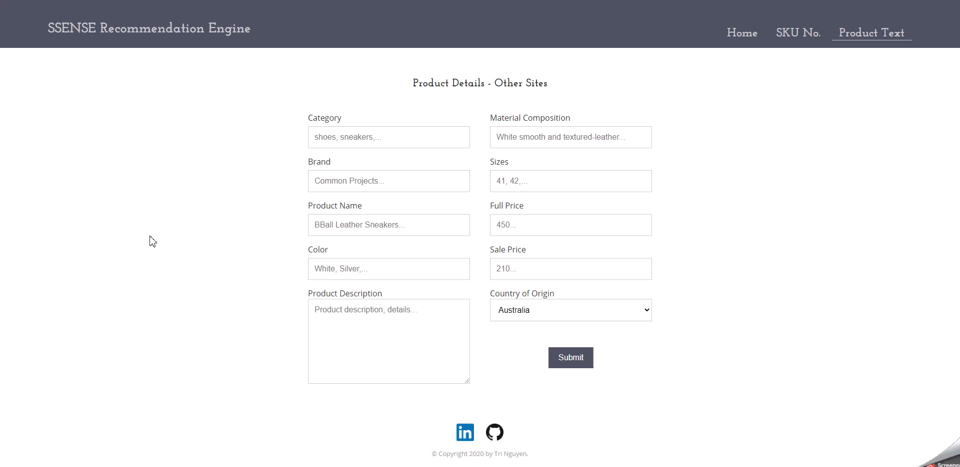

Slide 37
Business Impact Evaluations

Slide 38
Evaluations
Seen-to-purchased conversion rate of recommended products in wish lists
How many recommended items do users purchase after seeing on their list?
Purchase-to-search ratio for external products
Do searches of external products return high purchase conversion on SSENSE products?

Slide 39
Limitations & Next Steps

Slide 40
Limitations
There is no user review data
Cannot combined with collaborative filtering recommendation
Current model does not have the capability to evaluate and compare product photos
Combining image and text processing could lead to a powerful engine, but with higher infrastructure requirements

Slide 41
Next Steps
Allow users to prioritize a feature over others when searching
Flexibility to adjust feature weights
Add relevancy label to allow a more holistic evaluation of the recommended products
Metrics such as Coverage, Mean Average Precision at K (MAP@K) can be calculated to compare between different similarity metrics
More efficient backend data handling
PySpark vs Pandas DataFrames

Slide 42
Q & A

